Slide 1
Call Center Based Order Management And Inventory
Mohamed Nihal
Mes21mca-2022
Product owner : sayed feroz ahmed m

Slide 2
Table of Content
Introduction
Modules
Module Descriptions
Data Flow Diagram
Table Design
Developing Environment
User Story
Product Backlog
Project Plan

Slide 3
Call Center Based Order Management And Inventory
The proposed system is focusing on the customer relation management (CRM) with regarding to inventory management of the orders are being processed and delivered.
As so the replenishment of stock to the stock point and to increase the process flow of the management.
The application is producing a scope of automation in the field of CRM and in inventory to run the system in a fruitful and reliable way.

Slide 4
Call Center Based Order Management And Inventory
The main objectives are,
To build up the application with full working functionality of a call center on their order generation and to deliver it to the customer in a reliable manner.
With the COVID-19 pandemic disrupting businesses globally, remote work-enabled solutions are more necessary today than ever.
With a complete solution, the agents can connect to the center from anywhere while maintaining an efficient and personalized delivery.
For the requirements the system is planned to build the complete detailed module for each requirement.
As per the requirement and to built a web application in which consisting of taking an order from a customer to the final stage to delivering their required products to their homes.
The application gives the feature to know what all stock is available in their particular location also had planned to include the order to be allotted to the particular region to where the order is being generated and to transfer it to the pointed delivery boy.

Slide 5
Call Center Based Order Management And Inventory
The motivation behind such an application on order management is that we used to see many situations where even after ordering the product to the call center, the products are not being reached the hands of the customer at the right time.
As this, we conducted a study on what the problem happening with getting delayed of the product on the right time.
In the study, we got to know that the issue is due to a lack of proper channels or the lack of missing in coordination.
As our software system would support making workflow into a systematic manner and making the chain simpler.
So the product is delivered at right time from the delivery boys to the hands of customer.

Slide 6
Call Center Based Order Management And Inventory
Basic functionalities are,
Gathering the data from the customer about their requirement.
Placing of the order by the customer to the Business Process Executives using proposed system.
Allocating to different data to different districts delivery agents means to deliver the materials.

Slide 7
MODULES
Admin (for Master Entry) | Supervisor (Sales) | Business Process Executives (BPE)
User Management – Create user, Set/Reset Password, IP Configuration | Data Allocation | Lead Call Details Entry (New and Follow-up)
Product Management – Create New Product, Update the product details (Name & Price) | Lead Closing Confirmation | Lead Call Follow-up (Scheduled and pending)
Campaign wise Lead Exporting | BPE Performance Reports | Lead Call Follow-up Search
Update order information after confirmation | Order Tracking (Status) | Lead Closing and Order Details Entry
Campaign wise summary report (Lead and Order) | Oder Search with order date and order number | Direct Leads Entry
Inventory Order Management Order Summary Reports Inventory Reports |  | Order Tracking (Status)
BPE Performance Report |  | My Performance Report (Call and Order Summary)

Slide 8
MODULES
Delivery Supervisor (District Level) | Delivery Boy
Pending Order Show | Allocated Delivery Details
Order Allocation | Delivery Status Updating
Update on Delivery Remarks (If any) | User Feed Back Entry
Walk in Order Entry | Direct Order Entry
Inventory Report
Product Order Request to Admin
Order Tracking (Status)

Slide 9
MODULE DESCRIPTION
ADMIN
The Admin module is consisting of the task that of,
the user creation
product management
the process of checking of the data management
the complete management of the application carried out by the admin user
this user is will look after all the required changes by the subsequent other users.
SYSTEM ADMIN
The user functionality specified for system admin is of,
processing the data to the BPE on allocation basis
the user will be looking after all the subsequent BPE
confirmation the orders and forwarding the orders to State Coordinator Panel.

Slide 10
MODULE DESCRIPTION
STATE COORDINATOR
The user State Coordinator who is responsible for all the order allocation of the order to the different delivery agent.
The delivery agent will be having stocks of their particular location where the order is received.
have the authority of rejecting and cancellation of order
Have the supreme power on the delivery agents also
Can look after all the reports on the delivery of the orders.

Slide 11
MODULE DESCRIPTION
BPE (BUSINESS PROCESS EXECUTIVE)
The order processing from the leads which had been allocated from the system admin is being processed by the BPE
who deals with the customer and the required product order are being taken and the invoice is generated.
The order are moved to the system admin for the confirmation
later on the order are being processed and delivered to customers.
DELIVERY AGENT
The important module and simpler module in which the delivery agent who deliver the goods to the customer and update the delivery in application.

Slide 12
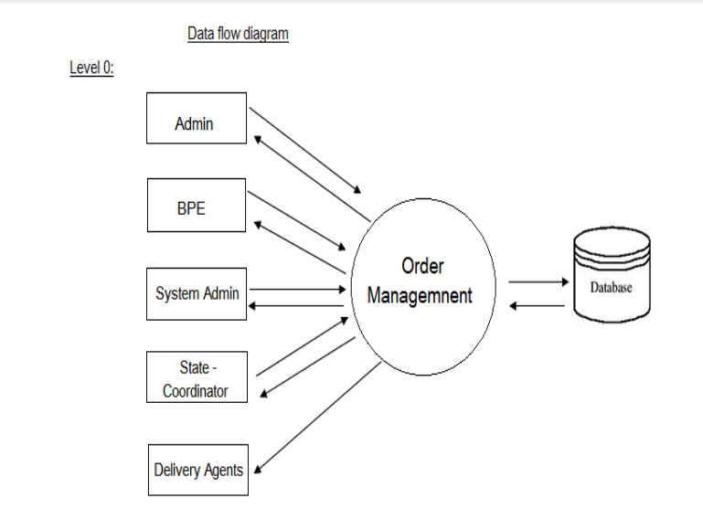
DATA FLOW DIAGRAM

Slide 13
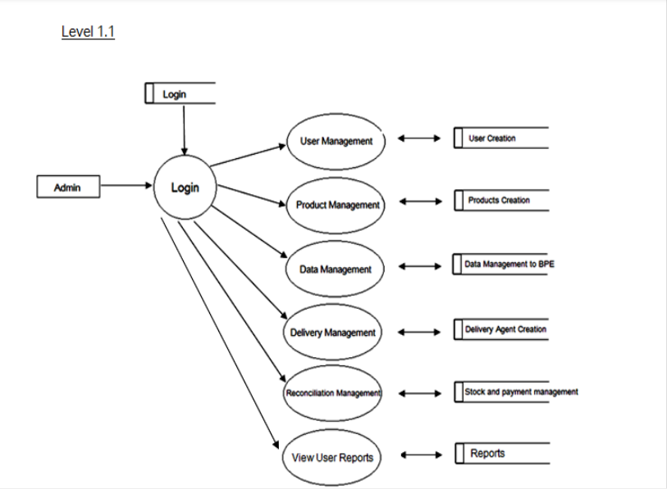
DATA FLOW DIAGRAM

Slide 14
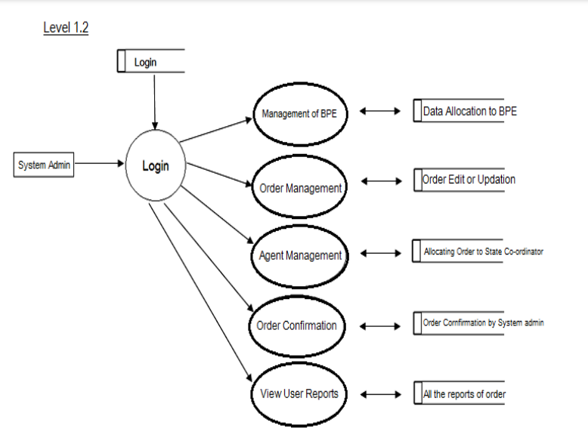
DATA FLOW DIAGRAM

Slide 15
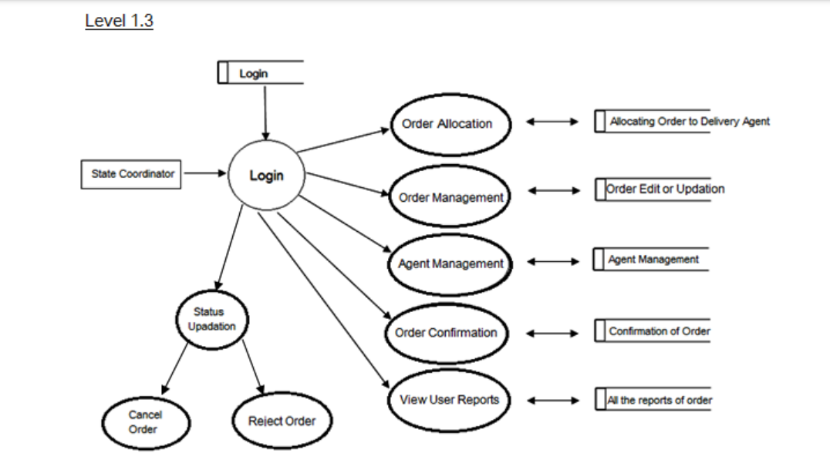
DATA FLOW DIAGRAM

Slide 16
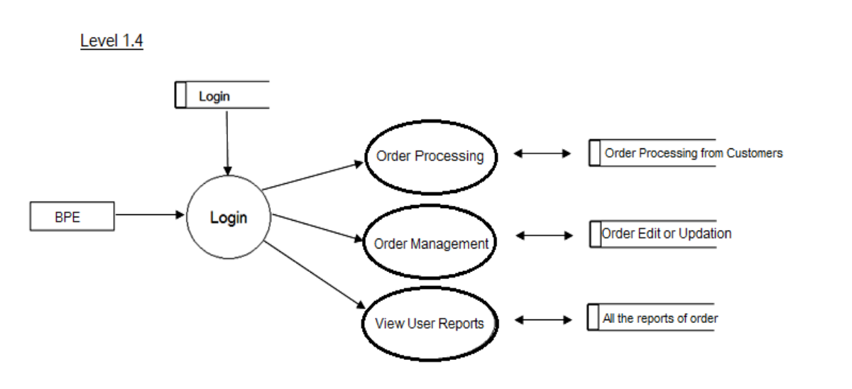
DATA FLOW DIAGRAM

Slide 17
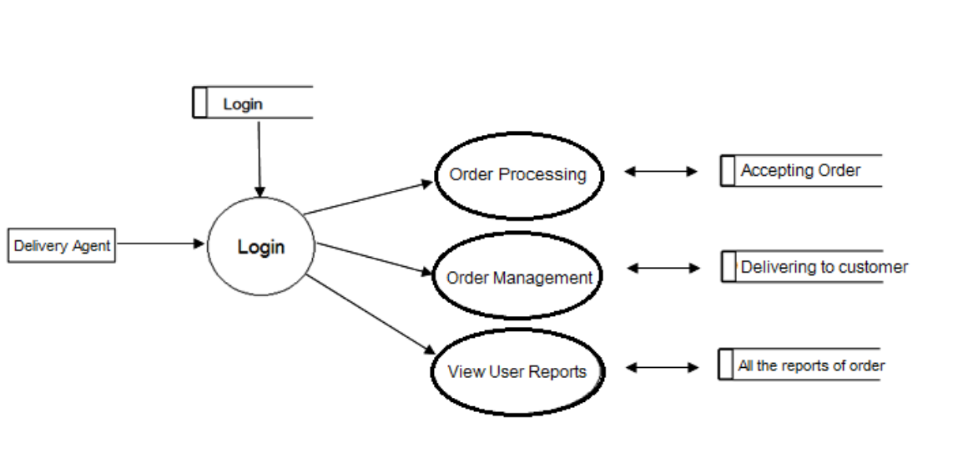
DATA FLOW DIAGRAM

Slide 18
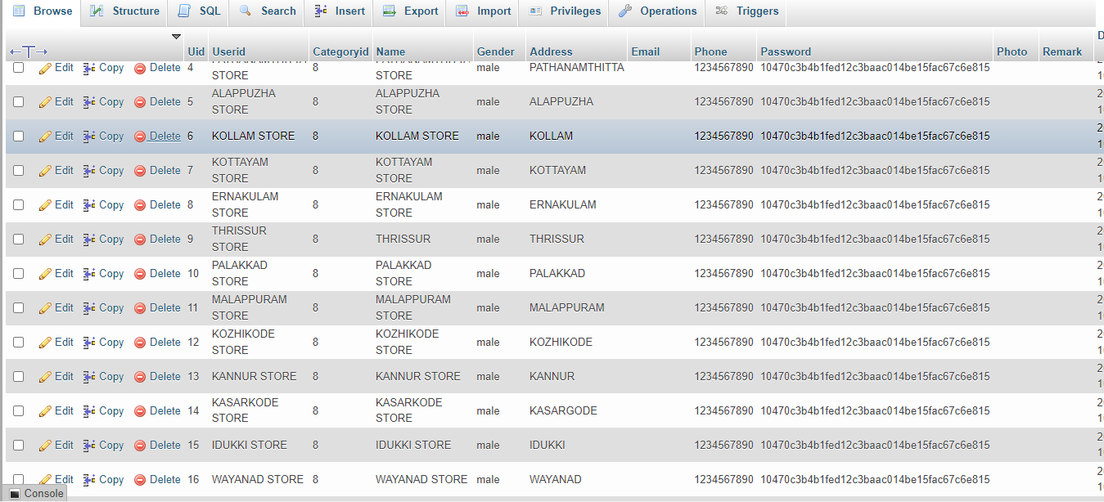
TABLE

Slide 19
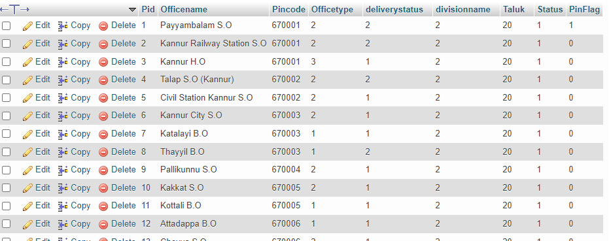
TABLE

Slide 20
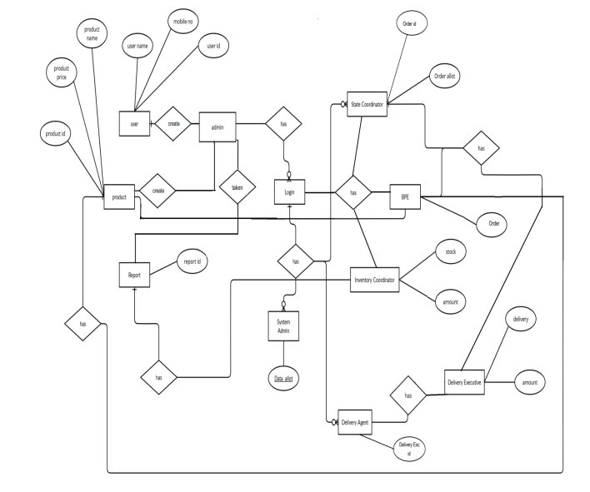
ER DIAGRAM

Slide 21
DEVELOPING ENVIRONMENT
HARDWARE REQUIREMENTS
It is recommended that for optimal performance, the following minimum hardware is installed on the server on which the portal is hosted, as well as on clients that access the portal.
PROCESSOR : Intel Pentium core 3
MONITOR : LCD Display
RAM : Min 2 GB
HARD DISK : 500 GB

Slide 22
DEVELOPING ENVIRONMENT
SOFTWARE REQUIREMENTS
For the proposed system to work properly, it is necessary that following software are installed and running on the server / client.
FRONT END : HTML5,CSS,Javascript,Bootstrap
BACK END : PHP
Database: MySQL
IDE : Visual Studio Code
TECHNOLOGY USED : Web
OPERATING SYSTEM : WINDOWS 7/8/10 for better performance
WEB BROWSER : Internet Explorer/Google Chrome/Firefox

Slide 23
USER STORY
User Story ID | As a type of User | I want to <Perform some task> | So that I can <Achieve Some Goal>
1 | ADMIN | Login | login successful with correct username and password
2 | ADMIN | View and Manage | Can view and Manage registered users, product, agents, inventory and payment
3 | ADMIN | Report | Customized different report
4 | SYSTEM ADMIN | Data Manage | Data allocation to BPE
5 | SYSTEM ADMIN | View and Manage Orders | Can view and edit the order generated by the BPE
6 | SYSTEM ADMIN | Agent Manage | Allocating Orders to State Coordinators
7 | SYSTEM ADMIN | Confirm Order | Order Confirmation

Slide 24
USER STORY
User Story ID | As a type of User | I want to <Perform some task> | So that I can <Achieve Some Goal>
8 | STATE COORDINATOR | Order Allocation | Allocation of the generated order to Delivery Agents
9 | STATE COORDINATOR | Status Changes | Reject, Cancel and Allot Orders
10 | STATE COORDINATOR | Report | Customized different report
11 | BPE (BUSINESS PROCESS EXECUTIVE) | View and Manage Order | Booking of order from the data
12 | BPE (BUSINESS PROCESS EXECUTIVE) | Report | Customized different report based on orders
13 | DELIVERY AGENT | Accept Orders | Accepting order for status updation.
14 | DELIVERY AGENT | Order Delivery | Delivering the orders
15 | DELIVERY AGENT | Report | Customized different report based on delivery.

Slide 25
PRODUCT BACKLOG
ID | NAME | PRIORITY <high/medium/law> | ESTIMATE (Hours) | STATUS <Planned/In progress/Completed>
1 | LOGIN GENERATION FOR USERS | High | 5 | Completed
2 | UPLOADING DATA AND ALLOCATION | High | 5 | Completed
3 | CRUD(Product ,Order ,Delivery ,Inventory) OPERATIONS | High | 20 | Completed
4 | ORDER ALLOCATION FOR DISTRICT | High | 6.5 | Completed
5 | INVENTORY (Stock and payment of delivery agents) | Medium | 7.5 | Completed
6 | ORDER DELIVERY | High | 6 | Completed

Slide 26
PROJECT PLAN
User Story ID | Task Name | Start Date | End Date | Days | Status
1 | Sprint 1 | 16/08/2022 | 17/08/2022 | 8 | Completed
4 |  | 18/08/2022 | 19/08/2022 |  | Completed
8 |  | 20/08/2022 | 22/08/2022 |  | Completed
11 |  | 23/08/2022 | 25/08/2022 |  | Completed
2 |  | 26/08/2022 | 27/08/2022 |  | Completed
5 | Sprint 2 | 13/09/2022 | 16/09/2022 | 15 | Completed
9 |  | 17/09/2022 | 21/09/2022 |  | Completed
6 |  | 22/09/2022 | 23/09/2022 |  | Completed
13 |  | 24/09/2022 | 27/09/2022 |  | Completed

Slide 27
PROJECT PLAN
User Story ID | Task Name | Start Date | End Date | Days | Status
7 | SPRINT 3 | 03/10/2022 | 06/10/2022 | 12 | Completed
14 |  | 07/10/2022 | 10/10/2022 |  | Completed
3 |  | 11/10/2022 | 14/10/2022 |  | Completed
10 | SPRINT 4 | 28/10/2022 | 03/11/2022 | 15 | Completed
12 |  | 04/11/2022 | 07/11/2022 |  | Completed
15 |  | 08/11/2022 | 11/11/2022 |  | Completed

Slide 28
SPRINT BACKLOG
Backlog item | Status And Completion Date | Original Estimation in Hours | Day 1 hrs | Day 2 hrs | Day 3 hrs | Day 4 hrs | Day 5 hrs | Day 6 hrs | Day 7 hrs | Day 8 hrs | Day 9 hrs | Day 10 hrs
SPRINT1
Table designing | 16/8/2022 | 2 | 1 | 1 | 0 | 0 | 0 | 0 | 0 | 0 | 0 | 0
Form designing | 22/8/2022 | 3 | 1 | 1 | 1 | 0 | 0 | 0 | 0 | 0 | 0 | 0
Coding | 27/8/2022 | 3 | 1 | 1 | 1 | 0 | 0 | 0 | 0 | 0 | 0 | 0
SPRINT 2
Data collection | 13/9/2022 | 7 | 1 | 1 | 1 | 1 | 1 | 1 | 1 | 0 | 0 | 0
Data processing | 29/9/2022 | 7 | 1 | 1 | 1 | 1 | 1 | 1 | 1 | 0 | 0 | 0

Slide 29
SPRINT BACKLOG
Backlog item | Status And Completion Date | Original Estimation in Hours | Day 1 hrs | Day 2 hrs | Day 3 hrs | Day 4 hrs | Day 5 hrs | Day 6 hrs | Day 7 hrs | Day 8 hrs | Day 9 hrs | Day 10 hrs
SPRINT3
Users Modules | 3/10/2022 | 7 | 1 | 1 | 1 | 1 | 1 | 1 | 1 | 0 | 0 | 0
Order Creations | 20/10/2022 | 7 | 1 | 1 | 1 | 1 | 1 | 1 | 1 | 0 | 0 | 0
SPRINT 4
Delivery | 8/11/2022 | 7 | 1 | 1 | 1 | 1 | 1 | 1 | 1 | 0 | 0 | 0
Testing | 15/11/2022 | 7 | 1 | 1 | 1 | 1 | 1 | 1 | 1 | 0 | 0 | 0
TOTAL |  | 50 | 9 | 9 | 8 | 6 | 6 | 6 | 6

Slide 30
THANKYOU

